Slide 1
EDA CREDIT CASE STUDY
By:
Prabhat Kumar
Sayanwita khaskel

Slide 2
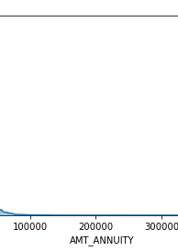
Distribution Plot for ANNUITY
1.Here,as we can see that it is left Skewed.
2.So,Missing Values are replaced with Median.

Slide 3
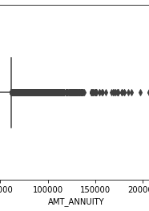
Outlier Checks
Here ,Outlier is checked for Annuity.
As ,we can see there is a point beyond 25k, and practically it is possible.

Slide 4
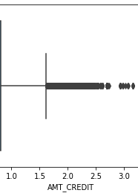
Outlier Check on AMT Credit
1.Here,we don’t have any outliers.

Slide 5
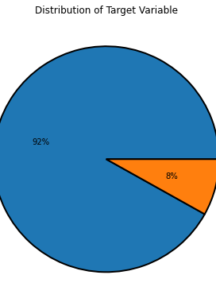
From Application Data
Defaulter is only 8% of total Population.

Slide 6
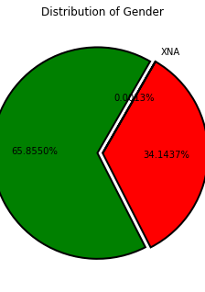
Distribution of Gender
Loan is applied mostly by Female.

Slide 7
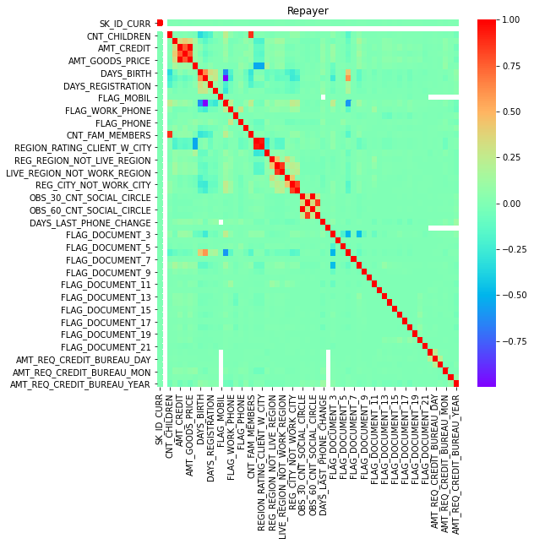
CORRELATION for Repayer

Slide 8
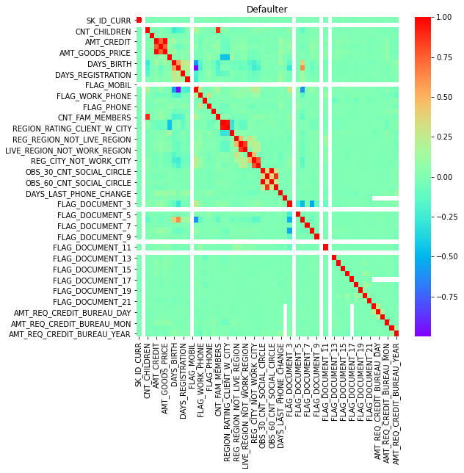
CORRELATION FOR DEFAULTER

Slide 9
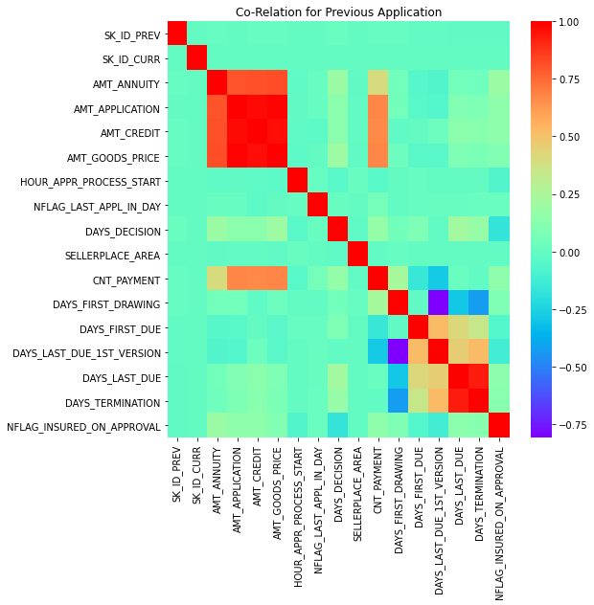
CORRELATION

Slide 10
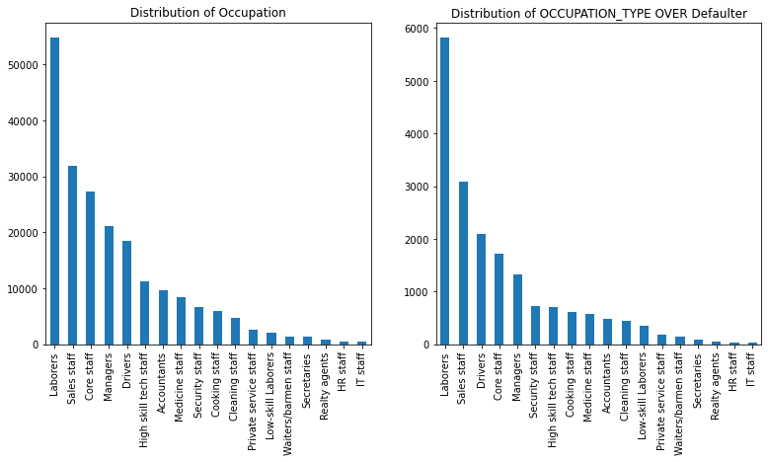
DISTIBUTION OF OCCUPATION TYPE
1.Overall,Laborer have mostly applied for loan.
2.So,In Defaulter their number is also high.

Slide 11
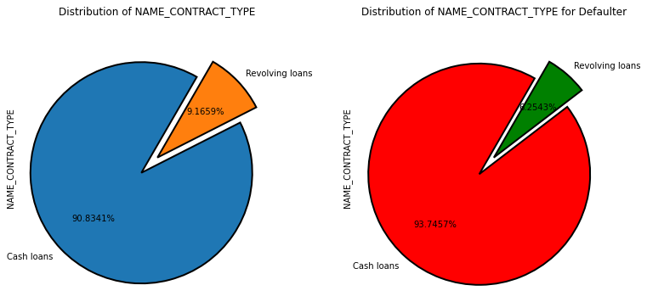
Distribution of Name contract Type
Mostly Cash is preferred over Resolving Loan.

Slide 12
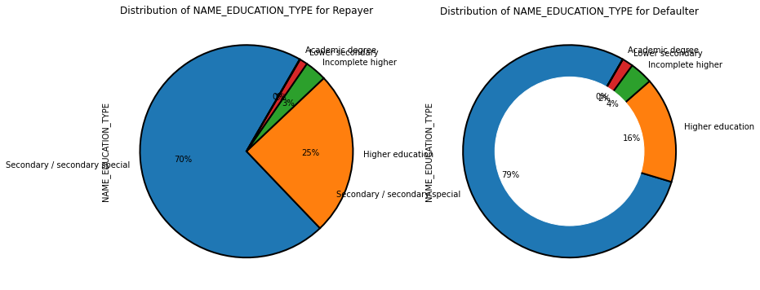
Distribution on EDUCATION TYPE
Repayer have 9% More Education Qualification.

Slide 13
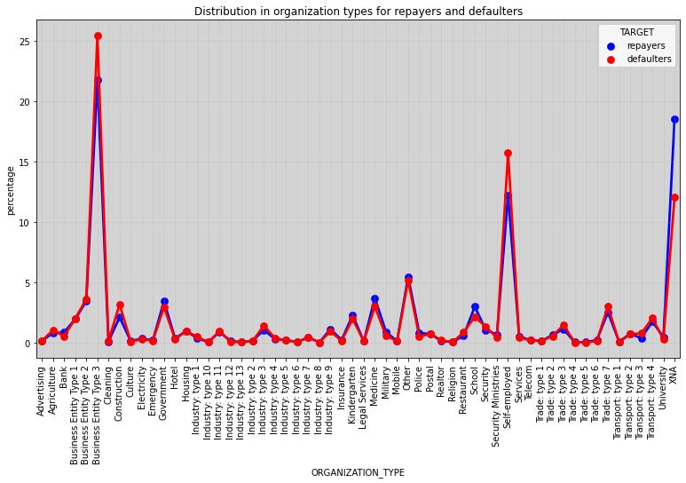
Distribution of Organization Type over Repayer and Defaulters
Organizations like Business Entity Type 3,Construction,Self-employed percentage of defaulters are higher than repayers.

Slide 14
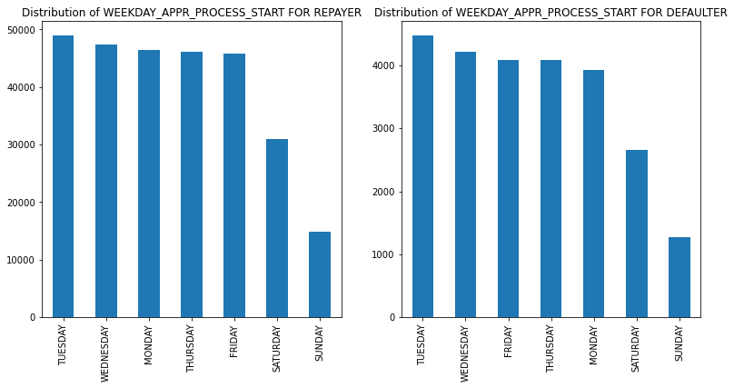
Distribution of Week Day Appr Process for Repayer and Defaulter
On Tuesday , Number of Defaulter applying for loan is higher

Slide 15
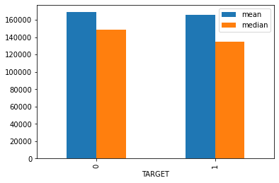
Distribution of Target over Income
1.Mean of income is almost same for both Repayer and Defaulter.
2.Median of income is lower for defaulter.
so, I think that before giving loan bank should check median of salary of defaulter or we can say that income greater than 1.4M should be considered for loan.

Slide 16
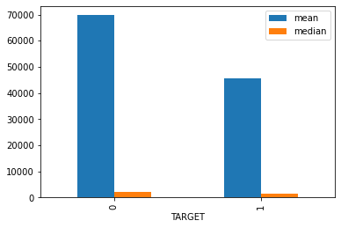
Distribution Of Target over Days Employed
1.From plot we can see that there is a huge difference in mean and median for Repayer and Defaulter.
2. It means ,Defaulters have recently started their job . So , I think ,there should be some rule regarding no. of days of employment.

Slide 17
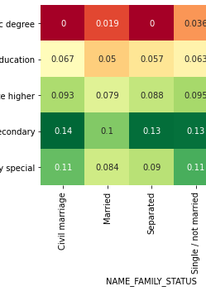
EDUCATION VS FAMILY STATUS VS TARGET
Folks who are separated , widow and have civil marriage with Academic Degree are mostly defaulters.

Slide 18
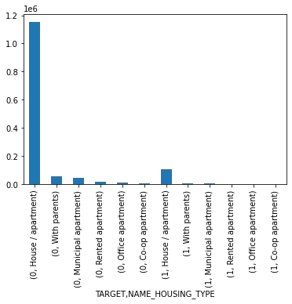
Distribution of Target over Housing Type
Repayer are mostly from House /Apartment.

Slide 19
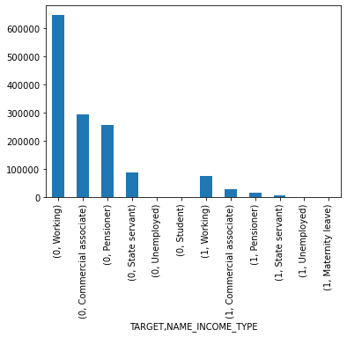
Distributor of Target over INCOME_TYPE

Slide 20
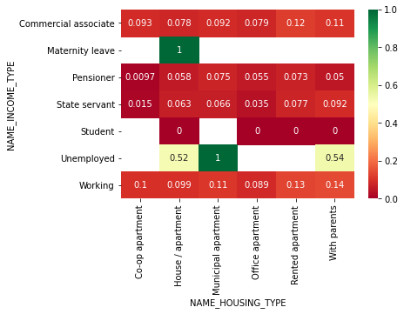
INCOMETYPE VS HOUSING TYPE VS TARGET
1.Banks should focus more on unemployed with Municipal Department.
2. Banks should focus more on Housing/Apartment with Maternity Leave.

Slide 21
Conclusion
Students , State Employees and Pensioner are the mostly Defaulters.
Bank should check the no. of employment days before giving loan and also the average income.
Should more focus on housing type (with Parents) as they can pay on time.

Slide 22
Thank You

